Slide 1
Jira

Slide 2
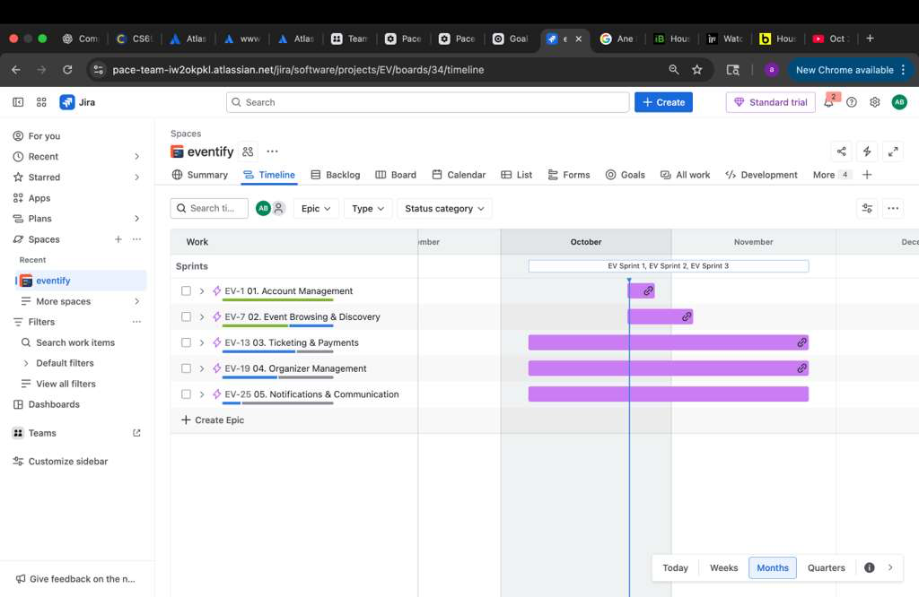
Timeline view
This shows the Timeline view of the Eventify project in Jira.
Each purple bar represents an Epic, such as Account Management, Event Browsing, Ticketing, Organizer Management, and Notifications.
The bars show how long each Epic runs and how they overlap across sprints in October and November.
It helps track project progress and dependencies between different features.

Slide 3
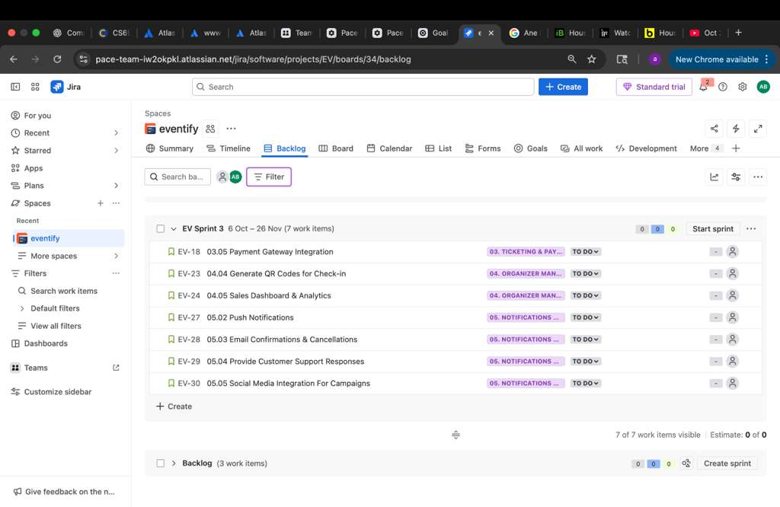
Backlog: Sprint 3
This one shows Sprint 3, containing 7 work items.
Tasks here are mostly related to Ticketing & Payments, Organizer Management, and Notifications modules.
Most items are currently in the “To Do” stage, meaning they’re planned but not yet started.
This view helps plan upcoming sprint activities and prepare the next development cycle.

Slide 4
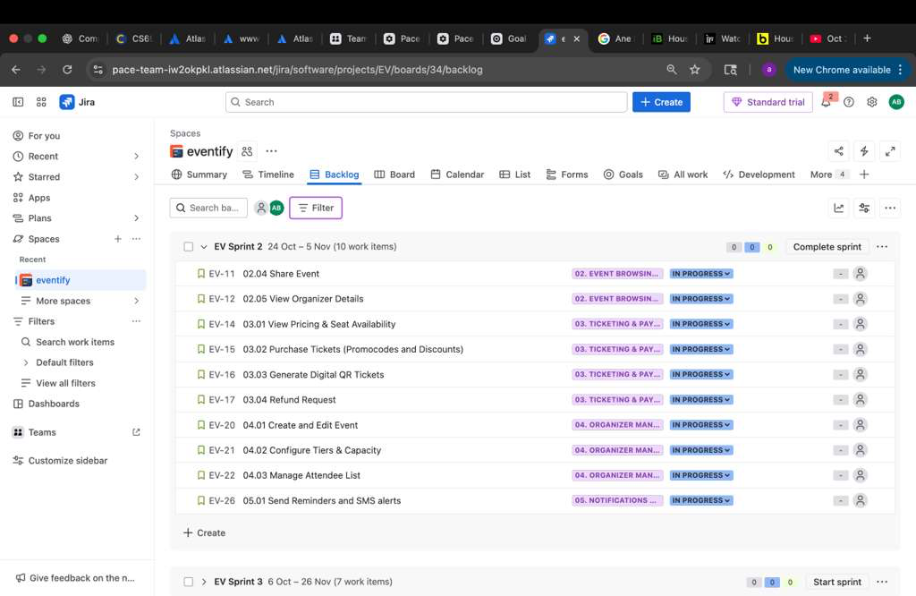
Backlog: Sprint 2
This image shows Sprint 2 tasks in the Backlog view.
It lists 10 user stories under Sprint 2, covering multiple Epics like Event Browsing, Ticketing, Organizer Management, and Notifications.
The blue labels indicate the Epic each task belongs to, and the “In Progress” status shows that the work has started.
This view helps manage all ongoing sprint activities and monitor task progress.

Slide 5
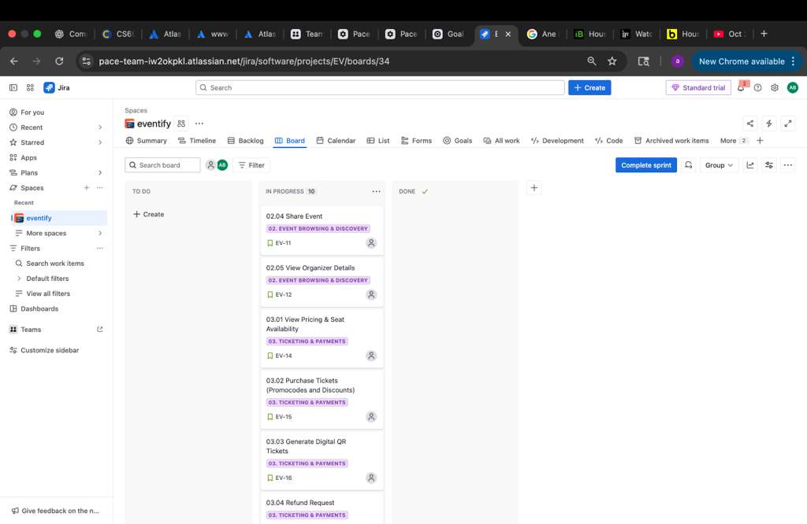
Jira Board View
This screen shows our Kanban board for the Eventify project.
Tasks are divided into three columns:
To Do: Tasks yet to be started.
In Progress: Tasks currently being worked on (e.g., “Share Event”, “Purchase Tickets”).
Done: Completed tasks.
Each task card shows the feature name, related epic, and the task ID (e.g., EV-11).
This view helps track team progress visually and ensures all tasks are actively managed during the sprint.

Slide 6
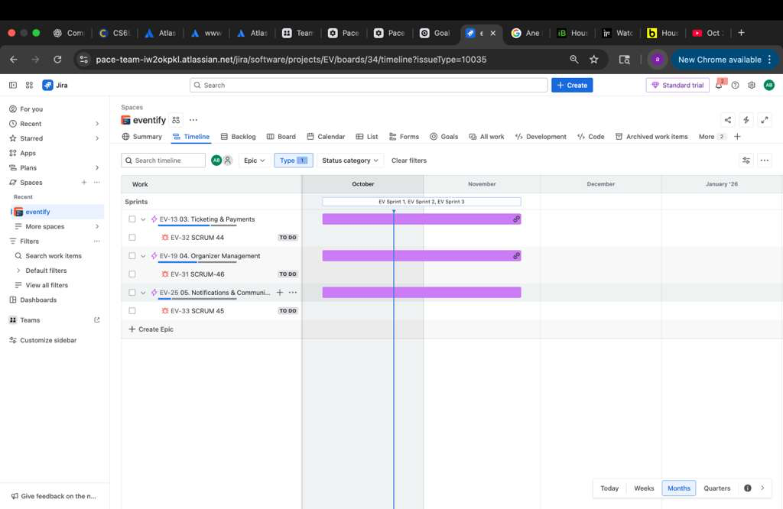
Jira Timeline
This screen shows the timeline view of our sprints and epics.
Each purple bar represents an Epic (like Ticketing & Payments, Organizer Management, etc.) and its schedule across October and November.
It helps visualize which epics are active during specific sprints (EV Sprint 1–3).
This view ensures the team stays on track with sprint deadlines and helps with planning and resource allocation.

Slide 7
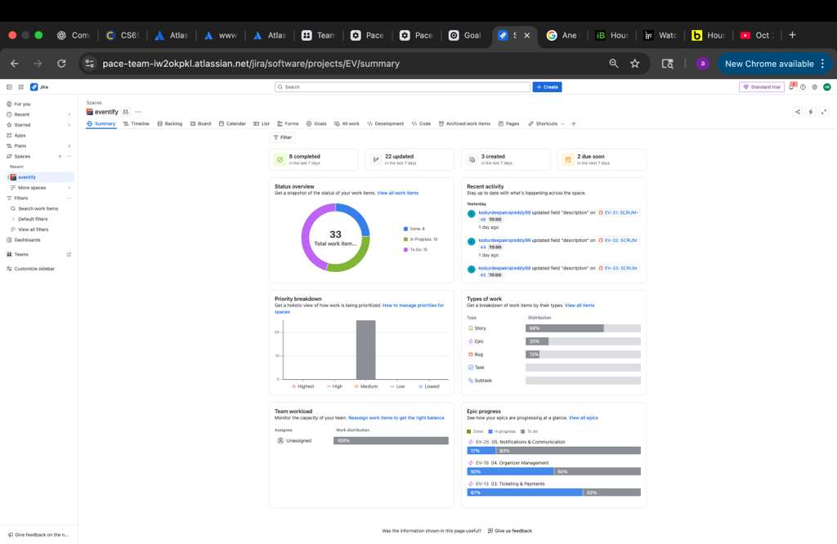
Jira Project Summary Dashboard
This screen summarizes the overall project progress.
It shows:
✅ 8 completed tasks and 📋 33 total work items.
A status chart showing work distribution by progress (To Do, In Progress, Done).
A priority breakdown showing most tasks have medium priority.
Epic progress bars for each major module like Ticketing & Payments, Organizer Management, and Notifications & Communication.
This view gives a quick snapshot of the team’s productivity and project health.

